Slide 1
AIR QUALITY MONITORING

Slide 2
ABSTRACT
The impact of pollution on public health and the environment.
This abstract provides an overview of recent advancements in air quality monitoring technologies and methodologies, including the use of sensor networks, satellite data, and machine leering algorithm.
The major pollutants air are gases such as ammonia, carbon monoxide, sulphur monoxide, sulphur oxides, methane etc.
The sources of pollutants are industrial emission, hazardous emissions from vehicles, burning of from vehicles, burning of fossil fuels etc.
Pollutant air can causes Severe health effects such as heart disease, lungs cancer, respiratory infections etc.

Slide 3
INTRODUCTION
Air quality monitoring is clean and healthy air is essential for the well-being of both the human health and environment.
Some project are important for understanding the impact of pollutants, both natural and human-made, on the atmosphere and public health.
Health problems are growing at faster rate especially in urban areas of developing countries where industrialization and growing number of vehicles release of lot of gaseous pollutants.
Due to air pollution 50,000 to 100,000 premature deaths per year occur in the U.S. alone whereas in EU number reaches to 300,000 and over 3,000,000 worldwide.

Slide 4
EXISTING SYSTEM
To collect parameters many electro mechanical devices are used
These devices are heavy and not economical to install at many places
Periodical collection of data is difficult
Still manual intervention is required for collecting and feeding data to central servers.

Slide 5
PROPOSED SYSTEM
Since its IOT based product all functional units are connected in a network
All things such as sensors base station, centralized server work together by means of communication over network
Data collected from sensors gets uploaded to cloud servers instantly
For authorities such as pollution control board, data is easily available
They can draw conclusions and take actions instantly

Slide 6
HARDWARE REQUIREMENTS
Processor
Hard disk
MQ7 sensors
RAM
Bread board
Jumper wires

Slide 7
SOFTWARE REQUIREMENTS
Front end
Programming Language
Editor
Operating System
IDE

Slide 8
ARCHITECTURE DIAGRAM
Database
Transmitter Module
Fetch data from sensor
Process the data
Send to server
Apache
webserver
Air quality Monitoring
Sensor Module
Receive
data
Process the data
Display the data

Slide 9
DATA FLOW CHART
1. Fetch gas content from AIR using MQ7
2. Process the data using libraries
3. Establish connection with server using Wi-Fi
4.Uploaded to database using server script
Data table

Slide 10
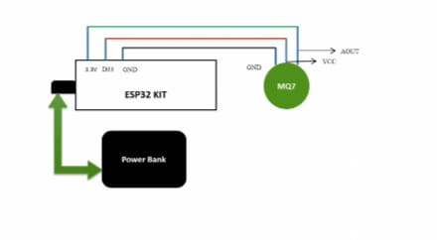
SCHEMATIC DIAGRAM

Slide 11
CONCULSION
It provides valuable data for assessing pollution levels, identifying sources of contamination, and implementing effective mitigation measures. As technology advances, the integration of IoT devices and real-time data analysis will further enhance our ability to address air quality issues promptly. Continued efforts in monitoring and improving air quality are essential for a cleaner and healthier future.

